Slide 1
Data Analysis of an Ecommerce website
Aman Singh
B.Tech <CSE>
3rd Year
COER University

Slide 2
AIM
Reduce Order Cancellation

Slide 3
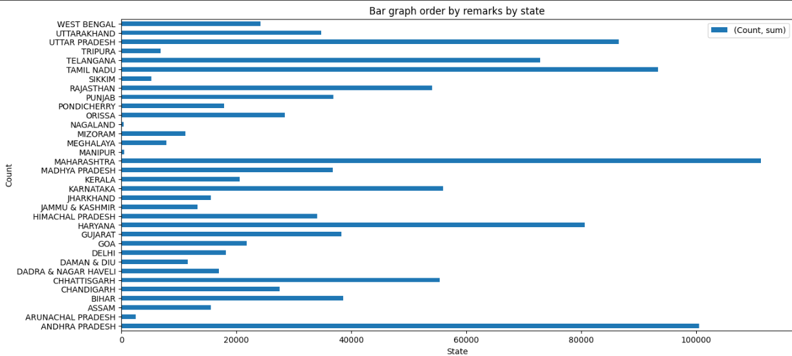
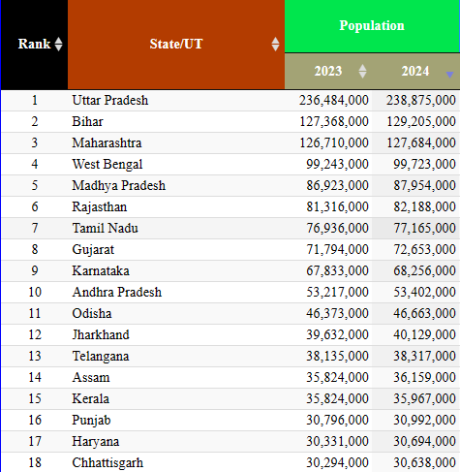
Insight 1/2
Andhra Pradesh
10th largest population
2nd most cancellation

Slide 4
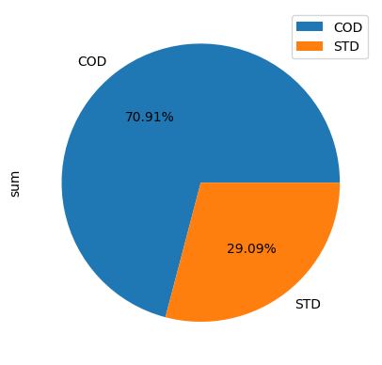
Insight 2/2
71% cancellations are COD.

Slide 5
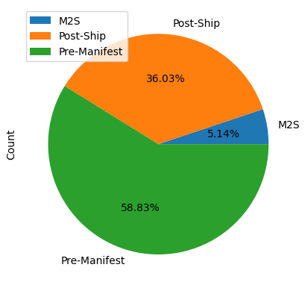
Solution 1/3
Andhra Pradesh
Reduce the Pre – manifest Phase by improving communication and Pick-up.

Slide 6

Solution 2/3
10 % discount coupons on pre-paid options.
Discount offers on next purchase.

Slide 7

Solution 3/3
Aapki apni dukan, ek click se door h….
Aadhunik Bharat ki h pahchan …
Digital hoga saara kaam …

